Slide 1
KINBERCON 2024
Digital Advertising – Utilizing adtech while avoiding liability through effective website privacy notices
April 18, 2024
Devin Chwastyk, CIPP/US/E,
Chair, Privacy & Data Security Group
dchwastyk@mcneeslaw.com
Christian Wolgemuth
Attorney, Privacy & Data Security Group
cwolgemuth@mcneeslaw.com

Slide 2
Digital Advertising – Utilizing adtech while avoiding liability through effective website privacy notices
50 U.S. state data breach notification laws
Emerging U.S. state privacy protection laws
California Consumer Privacy Act
Delaware and New Jersey follow
Pennsylvania on the horizon?
Proposed Federal Privacy Law
Privacy Litigation Risks
Digital Marketing Technology -- Pixel & Session Replay Litigation

Slide 3
State Privacy Laws

Slide 4
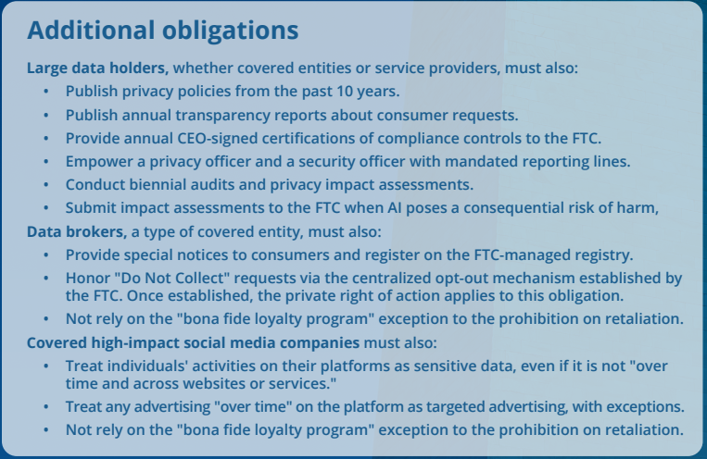
Proposed Federal Privacy Law
(Proposed) American Privacy Rights Act
Creates a privacy cause of action for privacy violations.
Would allow plaintiffs to seek data deletion, actual damages, and attorneys’ fees.

Slide 5
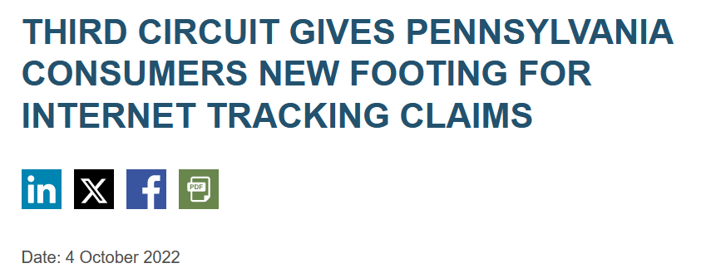
Privacy Litigation Is a Growing Risk in Pennsylvania

Slide 6
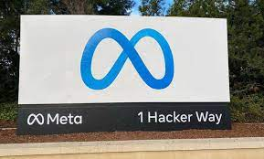
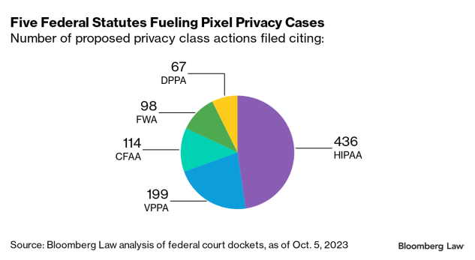
Privacy Litigation Is a Growing Risk in Pennsylvania
Digital Marketing Technology
Pixel & Session Replay Software
Special Risks for Healthcare Providers

Slide 7
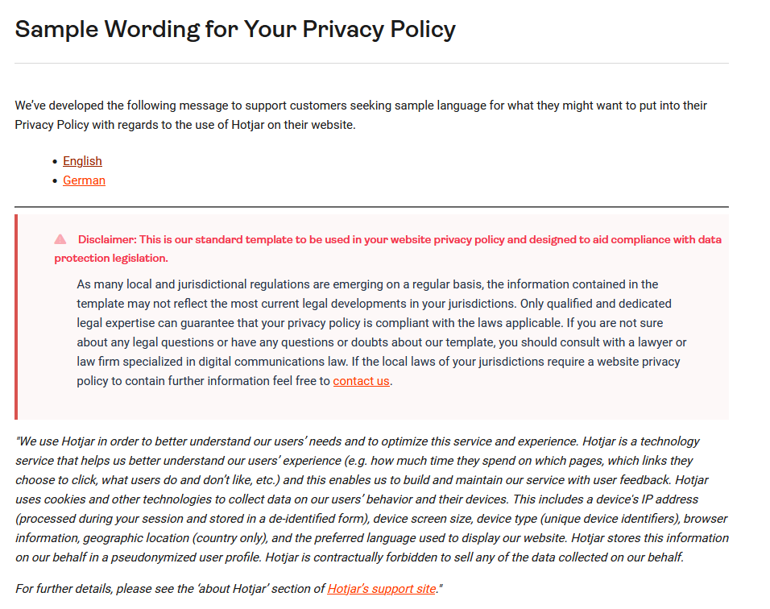
Example: Hotjar Privacy Policy Requirements

Slide 8
Questions?
Devin Chwastyk, CIPP/US/E
Chair, Privacy & Data Security Group
dchwastyk@mcneeslaw.com
www.twitter.com/DevinChwastyk
https://www.linkedin.com/in/devinchwastyk/

